Slide 1
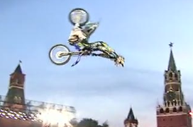
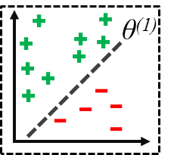
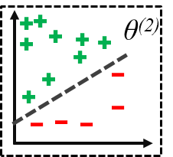
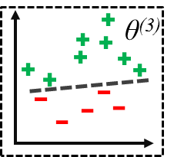
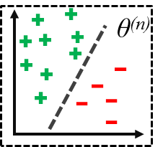
Active Collaborative Ensemble Tracking
POSTER-44
Kourosh Meshgi, Maryam Sadat Mirzaei, Shigeyuki Oba, Shin Ishii
Kyoto University, Graduate School of Informatics, Japan
SAMPLE
Main idea:
Add cooperation to ensemble tracking using active learning
Achievement:
Reduced label noise significantly, Robustness to appearance changes
UPDATE
Time Filter Δ
CLASSIFY
…
Sample Training Value
η
Flag
Z_{t}
Weights
A_{t}
Error
Detector
Active Resampler
Ensemble Labeler
LABEL
D_{t}
ESTIMATE

